Slide 1

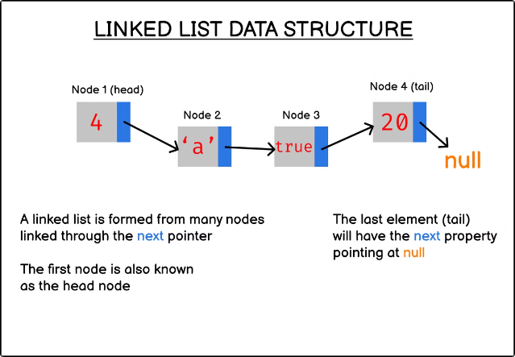
Linked List in Data Structures
Linked lists are dynamic data structures consisting of nodes, each containing data and a reference to the next node. They offer efficient memory usage and flexibility in dynamic data management, making them crucial in various applications.
PRESENTATION BY~
Aditi Karra and Nandini Molgara

Slide 2

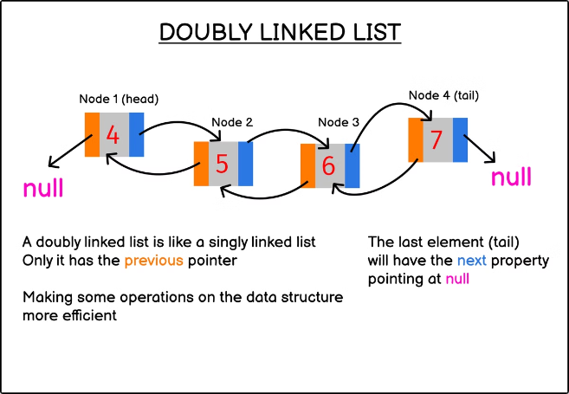
Introduction to Linked List
1
What is a Linked List?
A linked list is a dynamic data structure consisting of nodes where each node contains data and a reference (or pointer) to the next node in the sequence.
2
Why Linked Lists are Important?
Linked lists are important because they provide efficient memory usage and flexibility in dynamic data management.
3
Basic Structure of a Linked List
In a singly linked list, each node only points to the next node, forming a unidirectional chain.
4
Doubly Linked List
In a doubly linked list, each node has an additional pointer to the previous node, allowing traversal in both directions.

Slide 3
Types of Linked Lists
Single Linked List
Doubly Linked List
Circular Linked List
A singly linked list is a linear data structure consisting of nodes, where each node contains data and a pointer to the next node, allowing sequential traversal in one direction.
A doubly linked list is a linear data structure where each node contains data, a pointer to the next node, and a pointer to the previous node, enabling bidirectional traversal.
A circular linked list is a linear data structure where the last node's pointer points back to the first node, forming a loop, allowing continuous traversal without a null endpoint.

Slide 4

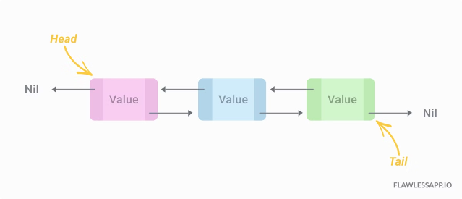
Single Linked List: Diagram Representation

Slide 5

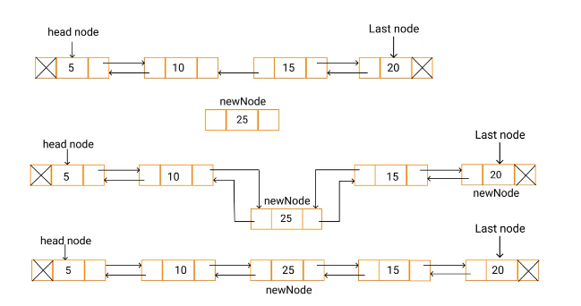
Basic Operations: Insertion
At the Beginning
A new node is inserted at the start of the list, and the head pointer is updated to this new node.
At the End
A new node is added after the last node, and the previous last node’s next pointer is updated to this new node.
At a Specific Position
A new node is inserted after a given node in the list, adjusting pointers accordingly.

Slide 6

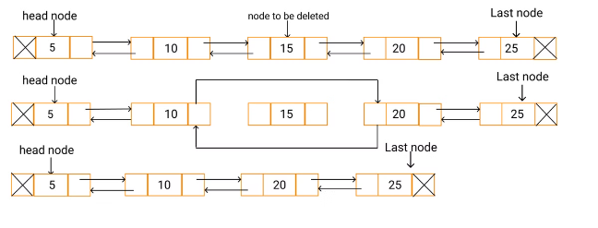
Basic Operations: Deletion
From the Beginning
The head pointer is updated to the next node, effectively removing the first node.
From the End
The second-to-last node’s next pointer is set to NULL, removing the last node.
From a Specific Position
The node before the target node is linked to the node after the target node, bypassing and removing the target node.

Slide 7
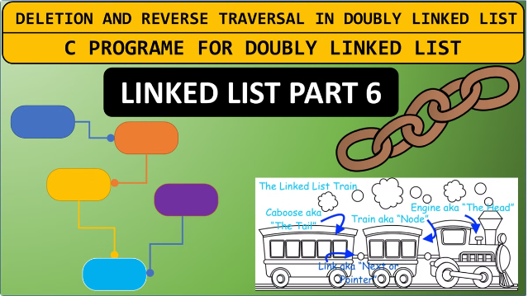
Basic Operations: Traversal
Starting from the head, each node is accessed sequentially until the NULL is reached. This operation is used to display the list's contents or search for a particular element.

Slide 8
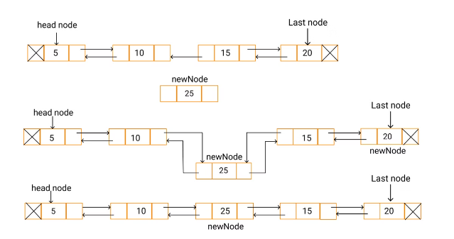
Double Linked List: Diagram Representation

Slide 9

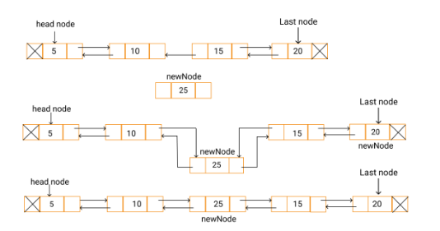
Basic Operations: Insertion (Double Linked List)
At the Beginning
At the End
At a Specific Position
Create a new node, set its Next pointer to the current head, and update the current head's Prev pointer to the new node. Then, update the head to the new node.
Traverse to the end of the list, create a new node, update the Next pointer of the current last node to the new node, and set the Prev pointer of the new node to the current last node.
Traverse to the desired position, adjust the pointers of the adjacent nodes to include the new node.

Slide 10

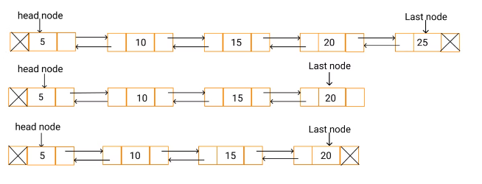
Basic Operations: Deletion (Double Linked List)
From the Beginning
Update the head to the next node and set its Prev pointer to NULL.
From the End
Traverse to the end, update the Prev pointer of the second-to-last node to NULL, and remove the last node.
From a Specific Position
Update the Next pointer of the node before the target node to point to the node after the target, and the Prev pointer of the node after the target to point to the node before the target.

Slide 11

APPLICATIONS OF LINKED LIST IN REAL LIFE CASES:
1.Music Players: Playlist Management: Music players use linked lists to manage playlists where each song is a node in the list. Users can add, remove, or rearrange songs efficiently.
2.Web Browsers: History Navigation: Web browsers use linked lists to keep track of the pages you visit. Each page in the browsing history is a node, and the browser can navigate back and forth using the linked list structure, allowing users to go back to previous pages.

Slide 12

ADVANTAGES
Dynamic Size: Explanation: Unlike arrays, linked lists do not require a fixed size at initialization. The size of a linked list can grow or shrink dynamically as elements are added or removed. example: In a contact list application where users can continuously add or remove contacts, a linked list can easily accommodate these changes without needing to resize or reallocate memory.
Efficient Memory Use: Explanation: Linked lists allocate memory for nodes as needed. Each node is allocated memory only when it is created, and this memory is deallocated when the node is removed. Example: In a real-time data processing system where the amount of data fluctuates, a linked list can help efficiently use memory by only allocating space for the currently active data.

Slide 13

DISADVANTAGES
Extra Memory for Pointers: Explanation: Each node in a linked list requires additional memory for storing pointers (or references) to the next (and possibly previous) node. Example: In memory-constrained environments, such as embedded systems, the extra memory required for pointers may be a limiting factor.
Slower Search: Explanation: Searching for an element in a linked list requires sequentially traversing the nodes from the head to the desired element. Example: In a large-scale application, such as a contact management system where users need to search for specific entries frequently, the linear search time of linked lists can impact performance.

Slide 14
CONCLUSION
Linked lists are versatile data structures that offer dynamic size, efficient memory usage, and ease of insertion and deletion, making them ideal for various applications. They come in different types, including singly linked lists, doubly linked lists, and circular linked lists, each suited for specific scenarios.
In Data Structures and Algorithms (DSA), linked lists play a crucial role. Their dynamic nature and ease of modifications make them valuable for implementing complex structures like stacks, queues, and even certain types of trees and graphs. They provide a foundation for understanding more advanced data structures and algorithms.
Exploring linked lists deepens your understanding of data management and memory utilization. Delve into advanced topics such as self-adjusting lists, skip lists, and circular buffers to expand your knowledge and apply linked lists in more sophisticated ways. Engaging with these topics will enhance your problem-solving skills and prepare you for tackling a wide range of programming challenges.

Slide 15
THANK YOU

